Slide 1
Language Modeling
A third approach

Slide 2

Conceive of documents as resulting from a data-generating process, or “Document Model”
a
long
the
there
long
time
was
been
time
long
In
beginning
the
It’s
a
ago…
Word
coming…
Document 1
Document 2
Document 3

Slide 3
Now, along comes a query
Query: time word
a
long
the
there
long
time
was
been
time
long
In
beginning
the
It’s
a
ago…
Word
coming…
Document 1
Document 2
Document 3

Slide 4
This retrieval model asks: What is the probability that Document_{i} would have generated this query?
Query: time word
a
long
the
there
long
time
was
been
time
long
In
beginning
the
It’s
a
ago…
Word
coming…
Document 1
Document 2
Document 3

Slide 5
This retrieval model asks: What is p(Q|D_{i})?
Query: time word
a
long
the
there
long
time
was
been
time
long
In
beginning
the
It’s
a
ago…
Word
coming…
Document 1
Document 2
Document 3

Slide 6
This retrieval model asks: For each word “w” in the query, what is the probability that a random draw from this document would be “w”?
Query: time word
a
long
the
there
long
time
was
been
time
long
In
beginning
the
It’s
a
ago…
Word
coming…
Document 1
Document 2
Document 3

Slide 7
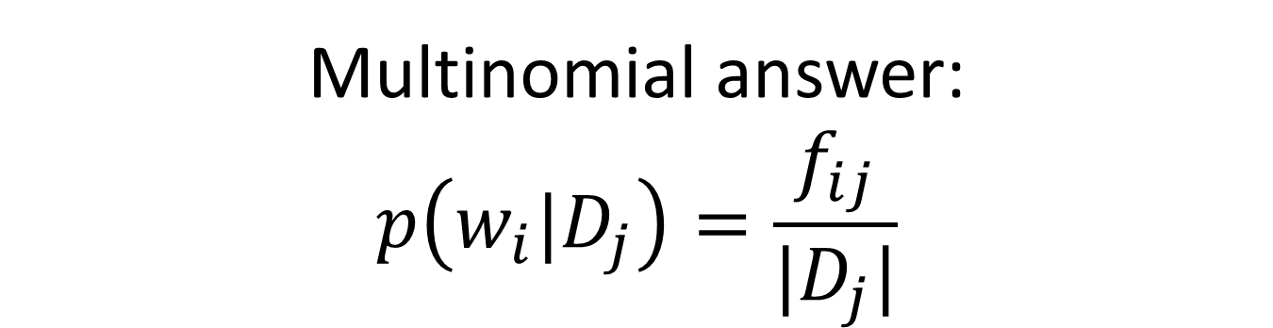
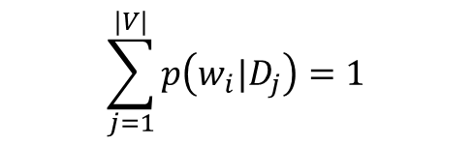
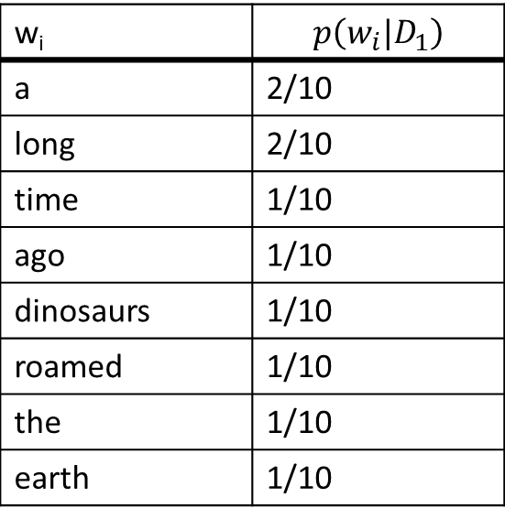
Multinomial answer: $$p\left(w_{i}|D_{j}\right)=\frac{f_{ij}}{|D_{j}|}$$
$$\sum_{j=1}^{|V|}{p\left(w_{i}|D_{j}\right)=1}$$
w_{i} | $$p\left(w_{i}|D_{1}\right)$$
a | 2/10
long | 2/10
time | 1/10
ago | 1/10
dinosaurs | 1/10
roamed | 1/10
the | 1/10
earth | 1/10
“A long, long time ago,
a dinosaur roamed the earth”
Document 1

Slide 8
If draw two words from this machine called D1, what is probability the two words will be “time”, “word”?
Query: time word
w_{i} | $$p\left(w_{i}|D_{1}\right)$$
a | 2/10
long | 2/10
time | 1/10
ago | 1/10
dinosaurs | 1/10
roamed | 1/10
the | 1/10
earth | 1/10
“A long, long time ago,
a dinosaur roamed the earth”
Document 1

Slide 9
If draw two words from this machine called D1, what is probability the two words will be “time”, “word”? Answer: 1/10 * 0/10
Query: time word
w_{i} | $$p\left(w_{i}|D_{1}\right)$$
a | 2/10
long | 2/10
time | 1/10
ago | 1/10
dinosaurs | 1/10
roamed | 1/10
the | 1/10
earth | 1/10
“A long, long time ago,
a dinosaur roamed the earth”
Document 1

Slide 10
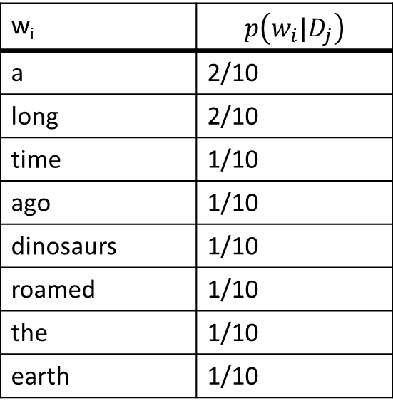
Answer was: 1/10 * 0/10? Time for smoothing!
Query: time word
w_{i} | $$p\left(w_{i}|D_{j}\right)$$
a | 2/10
long | 2/10
time | 1/10
ago | 1/10
dinosaurs | 1/10
roamed | 1/10
the | 1/10
earth | 1/10
“A long, long time ago,
a dinosaur roamed the earth”
Document 1

Slide 11
For smoothing, calculate corpus-wide probabilities
a
long
the
there
long
time
was
been
time
long
In
beginning
the
It’s
a
ago…
Word
coming…
Document 1
Document 2
Document 3

Slide 12


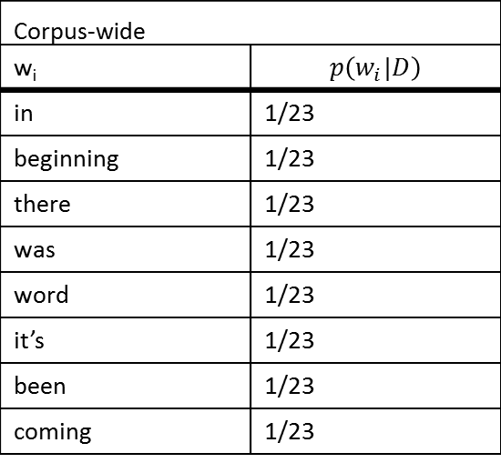
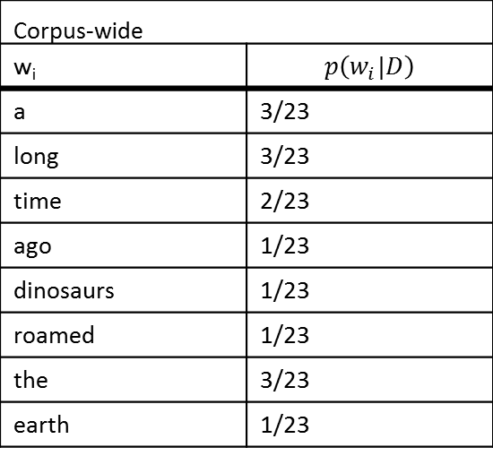
For smoothing, calculate corpus-wide probabilities
_{Corpus-wide}
w_{i} | $$p\left(w_{i}|D\right)$$
a | 3/23
long | 3/23
time | 2/23
ago | 1/23
dinosaurs | 1/23
roamed | 1/23
the | 3/23
earth | 1/23
_{Corpus-wide}
w_{i} | $$p\left(w_{i}|D\right)$$
in | 1/23
beginning | 1/23
there | 1/23
was | 1/23
word | 1/23
it’s | 1/23
been | 1/23
coming | 1/23
“A long, long time ago,
a dinosaur roamed the earth”
In the beginning, there
was the Word
It’s been a long time
coming
Document 1
Document 2
Document 3

Slide 13
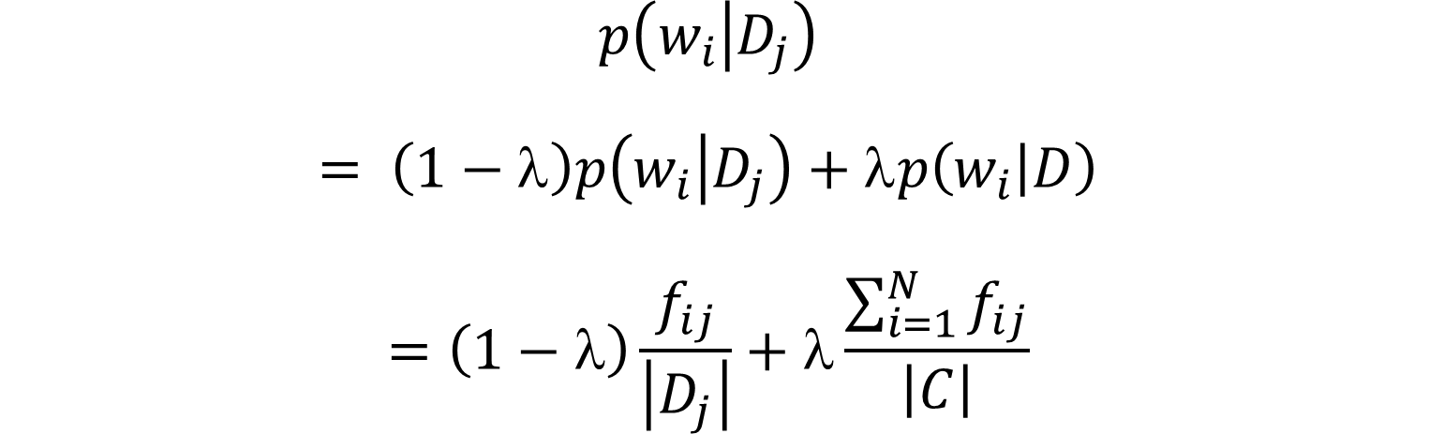
Smoothed p(wi|Dj)
$$p\left(w_{i} | D_{j}\right)$$
$$= \left(1−\right)p\left(w_{i} | D_{j}\right)+p\left(w_{i} | D\right)$$
$$=\left(1−λ\right)\frac{f_{ij}}{\left|D_{j}\right|}+λ\frac{\sum_{i=1}^{N}{f_{ij}}}{\left|C\right|}$$

Slide 14
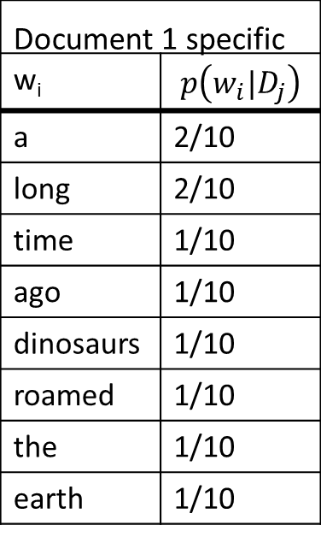
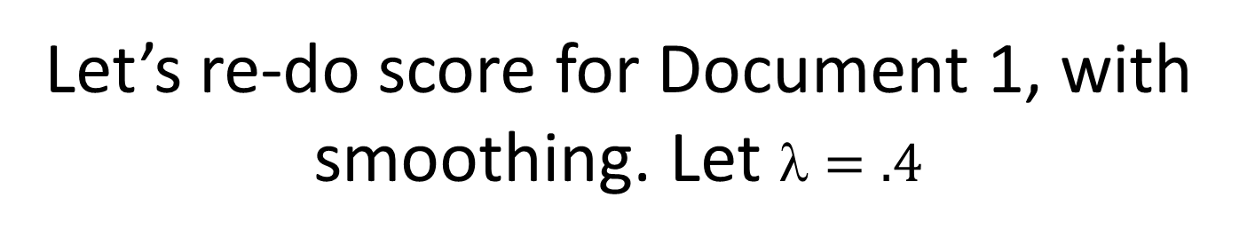
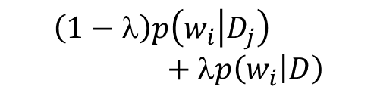
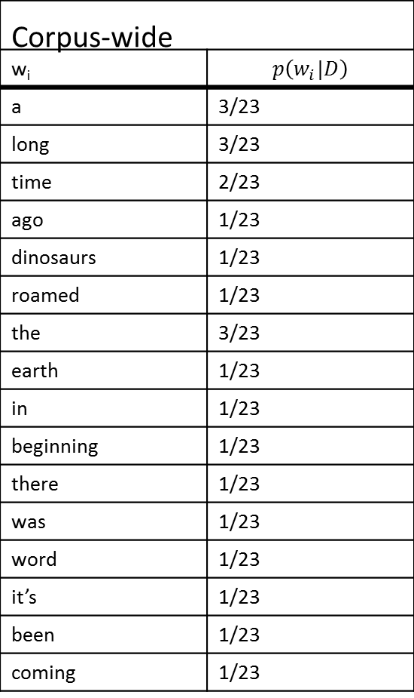
Let’s re-do score for Document 1, with smoothing. Let $=.4$
_{Corpus-wide}
w_{i} | $$p\left(w_{i}|D\right)$$
a | 3/23
long | 3/23
time | 2/23
ago | 1/23
dinosaurs | 1/23
roamed | 1/23
the | 3/23
earth | 1/23
in | 1/23
beginning | 1/23
there | 1/23
was | 1/23
word | 1/23
it’s | 1/23
been | 1/23
coming | 1/23
Query: time word
_{Document 1 specific}
w_{i} | $$p\left(w_{i}|D_{j}\right)$$
a | 2/10
long | 2/10
time | 1/10
ago | 1/10
dinosaurs | 1/10
roamed | 1/10
the | 1/10
earth | 1/10
$$\left(1−\right)p\left(w_{i} | D_{j}\right)+p\left(w_{i} | D\right)$$
[(1-.4)*1/10 + .4*2/23]
*
[(1-.4)*0 + .4*1/23]

Slide 15
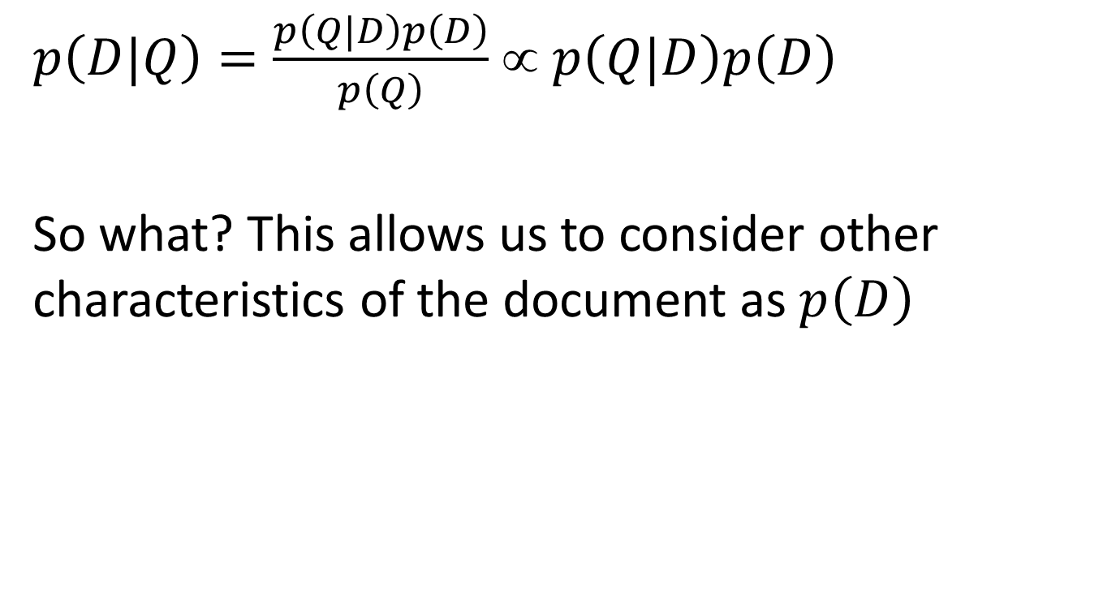
Bayes
$p\left(D|Q\right)=\frac{p\left(Q|D\right)p\left(D\right)}{p\left(Q\right)}$ ∝ $p\left(Q|D\right)p\left(D\right)$
So what? This allows us to consider other characteristics of the document as $p\left(D\right)$

Slide 16
3 IR models
הסתברותי
p(D|R) / p(D|NR)
VSM
Cosine(D,Q)

Slide 17
3 IR models
הסתברותי
p(D|R) / p(D|NR)
VSM
Cosine(D,Q)
Language Models
p(Q|D)

Slide 18
VSM vs. Version-1-Probabilistic
Language Modeling | Binary Probabilistic (version 1) | VSM
No | No (doesn’t care what query is) | Yes | Compare document with query?
Yes | No | Yes | Naturally uses term frequency?
No (doesn’t know what relevance is) | Yes | No | Naturally uses history of relevance?
Yes | Yes | No | Based on theory?

